Slide 1



SIDDAGANGA INSTITUTE OF TECHNOLOGY
TUMKUR, KARNATAKA - 572103
DEPARTMENT OF COMPUTER SCIENCE AND ENGINEERING
MAJOR PROJECT
RECORD.AI
Presented By:
CHINMAY R C (1SI17CS027)
MRINAL RAJ (1SI17CS062)
SARTHAK MISHRA (1SI17CS097)
PANEL CONVENER: A.H SHANTHAKUMARA
PROJECT GUIDE: Dr SHOBHA K

Slide 2
INTRODUCTION
The prefectural concept of preventing ourselves from fraud and keeping a record in form of text, has been a topic of discussion for generations.
The non-legitimate calls’ identification finds its application in telephonic calls, type of Speech Recognition, in agents like Amazon Alexa, Apple Siri, or Google Assistant.
The AI at this point of development has given the ML classifiers to make the model on. However, the costs increase when large file sized audio signals are sampled at higher rate.
Integration of ML model with Android, makes the software easy-to-use.

Slide 3

OBJECTIVES
Recording of call
Detection of Non-Legitimate Call
Classification of Non-legitimate Call
Call record history
Transcription of conversations
Userfriendly Interface

Slide 4
DOES ANYONE REALLY USE FRAUD CALL CLASSIFICATION?
Google Assistant
Amazon Alexa
Apple Siri
Spoken Language Translation
Spoken Document Retrieval
Multilingual Speech Recognition

Slide 5
PROBLEM/NEED
Variation in type of speech input and broad classification – Spam/Fraud/Threat/Blackmail
Understanding how human beings comprehend non-legitimate calls
Unlike raw images, raw speech is complex and not suitable for model
Larger the audio, higher the cost (computation-time)

Slide 6
CONTRIBUTIONS MADE SO FAR
Promising results are obtained for Spam text messages, fraud emails, threat and blackmail texts.
OneVsRest Classifiers tend to combine the classifiers for multi-type input.
Recording
Background service
Storage format – mp3/wav
Integration
Allows ML model to be integrated with Android

Slide 7
CLASSIFICATION OF NON-LEGITIMATE CALLS
SPAM
FRAUD
THREAT
BLACKMAIL

Slide 8

HOW DOES HIGH-LEVEL DESIGN REALLY LOOK LIKE?

Slide 9
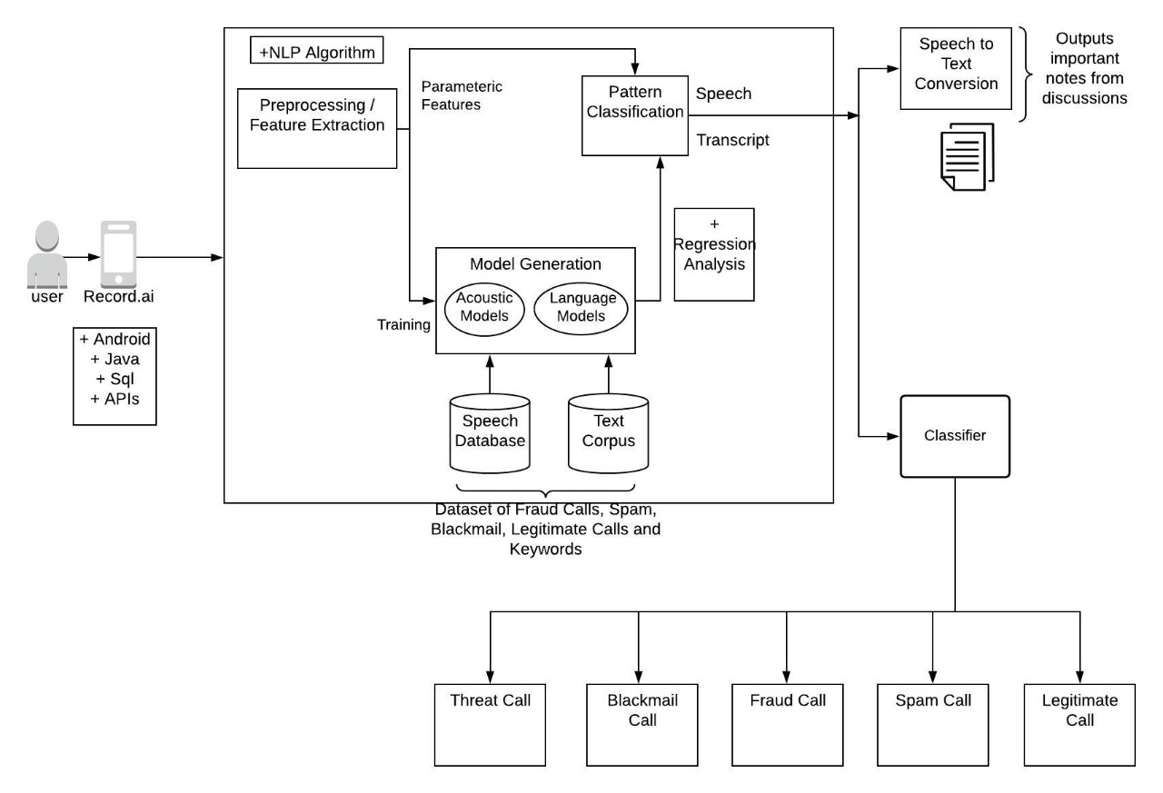
How does its architecture look like?

Slide 10
IMPLEMENTATION

Slide 11
ALGORITHM
Step1: Dataset Preparation – We extracted data from different reliable sources including Kaggle and Machine Learning dataset repositories, for each type of classification i.e., spam, fraud, legit, blackmail and threat.
Step2: Machine Learning Algorithm – Data is fed in the form of 2D matrix as input.
To define the model, we have used Keras model defining input in the form of input layer, and using classifiers to train it using the prepared dataset. A sigmoid function is used at the output to get it in the range 0 and 1 i.e., probabilities for each label. Hence, the output layer has only 1 node.
After defining the model, we compiled it using TensorFlow.
Next, we fit the model on dataset, then evaluate the model accuracy and test it on test data.

Slide 12
ALGORITHM
Step3: Conversion function - After the model is trained, we converted and stored it in the tflite format, using TFLite converter function, to integrate it with the android app.
Step4: Processing - Prepare the call data using Stop words removal, Tokenizer and string to integer conversion process. It is then fed to the model stored in tflite format and we get output in the form of 2D array having 1 row and 5 columns, one for each type of classification result.
Step5: Display Results - The output is processed to get probabilities and show the overall call type of one having maximum probability.

Slide 13
RECORD.AI APP
Recording: The app records the telephonic conversation by running in background as a service.
Identifies the incoming and outgoing call.
Starts recording the call.
Stores the recorded audio clip in a file.
This file is stored only in user’s mobile and can be accessed by the user at any-time.
Speech-to-Text: The app uses Google Speech Recognition API to convert speech to text. It can be used while the call continues.
Once the call ends, the recorded conversations in the form of text are stored in the form of ‘Notes’ i.e. txt format.

Slide 14
RECORD.AI APP
Call Type: Using the pre-trained Machine Learning model, it classifies the call into the categories namely
Spam
Fraud
Threat
Blackmail
Legit
As a result, every call gets mapped to its call type regardless of the phone number.
User confidentiality: In the view of maintaining confidentiality, storing of the audio file, storing of the notes, and result of the call type are all stored at the user side so that there is no risk of revealing the confidential information to anybody else.

Slide 15
RESULTS

Slide 16
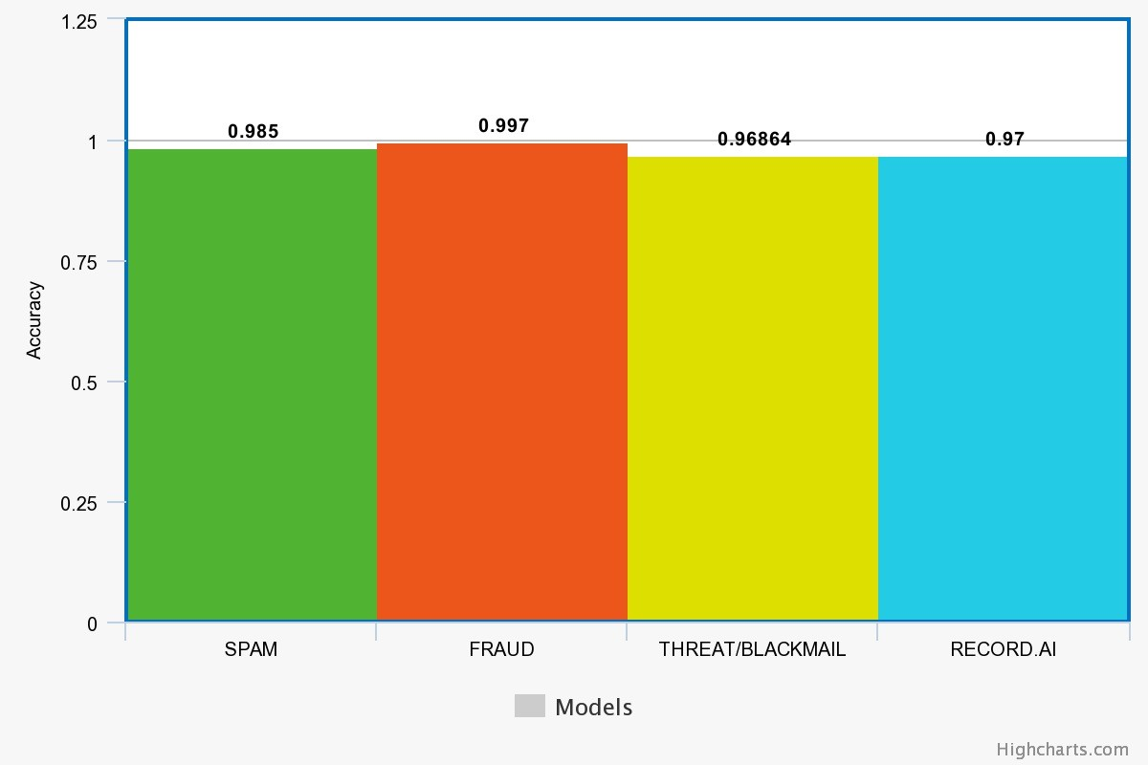
PERFORMANCE
Fig.: Comparison of accuracies of existing classifiers with Record.AI model

Slide 17
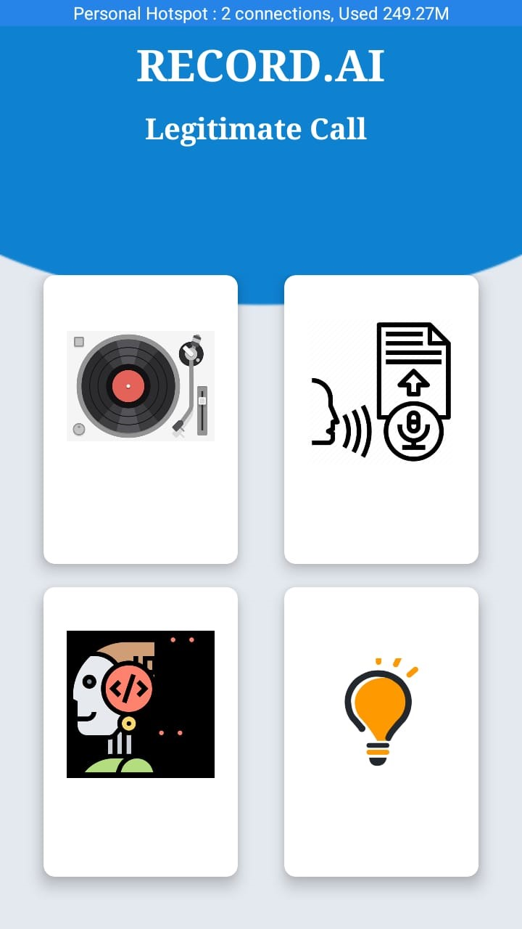
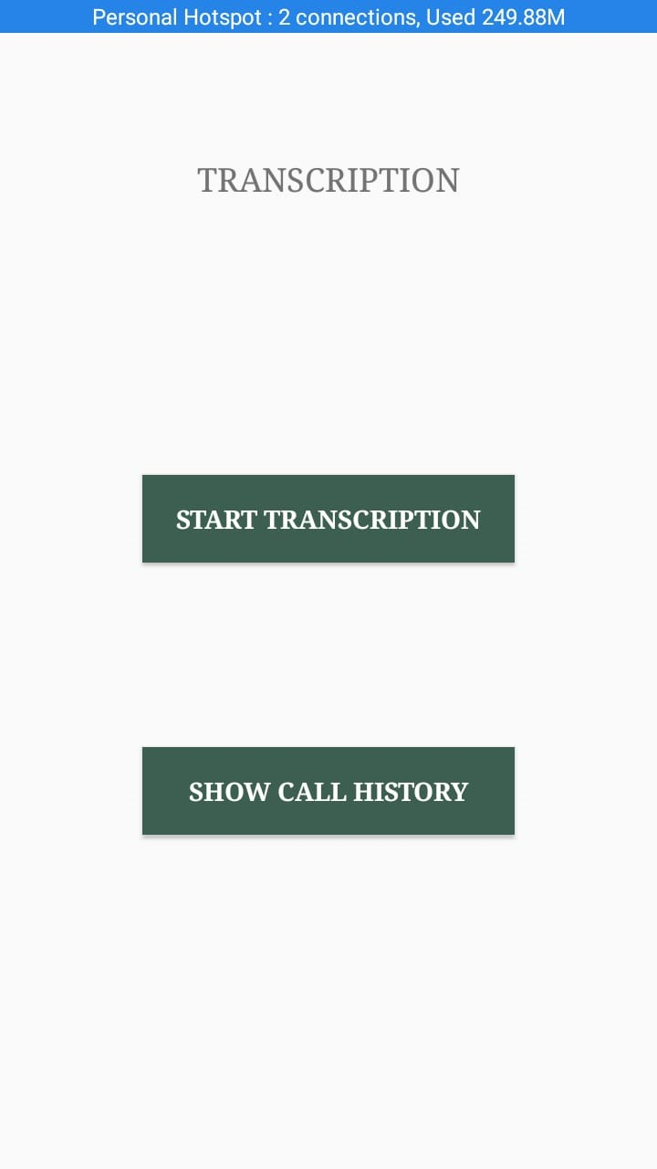
HOME PAGE

Slide 18
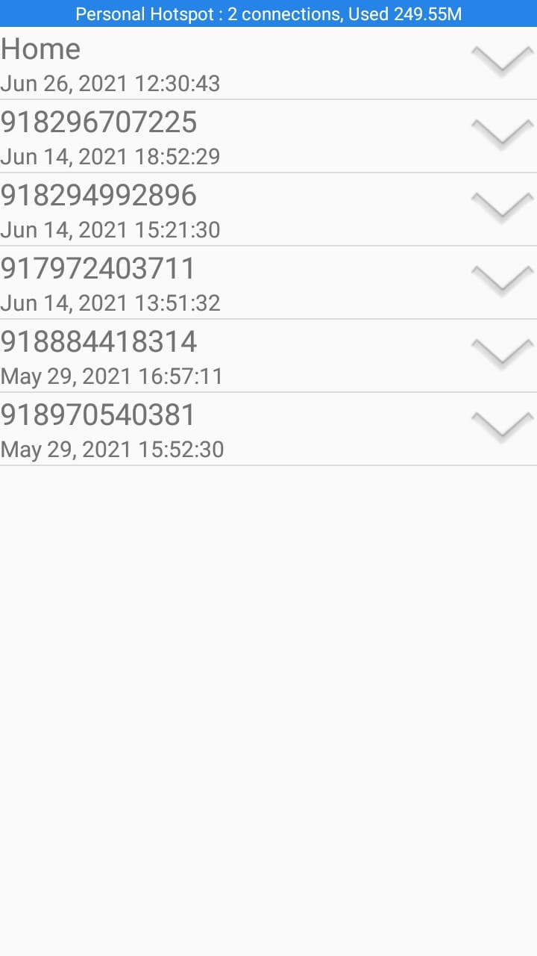
RECORDINGS

Slide 19
TRANSCRIPTION

Slide 20
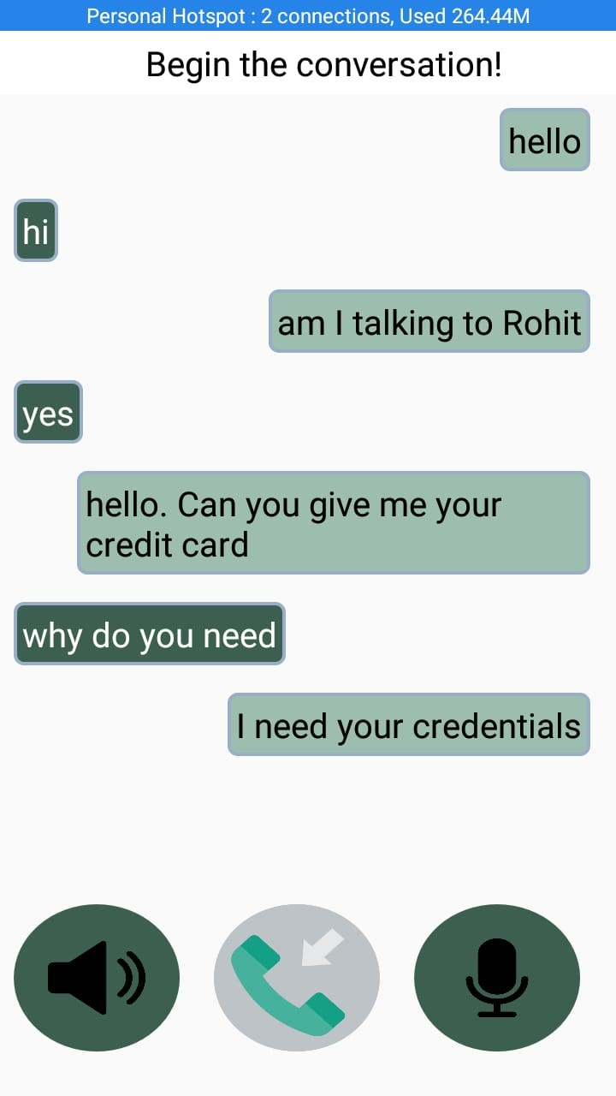
CONVERSATION

Slide 21
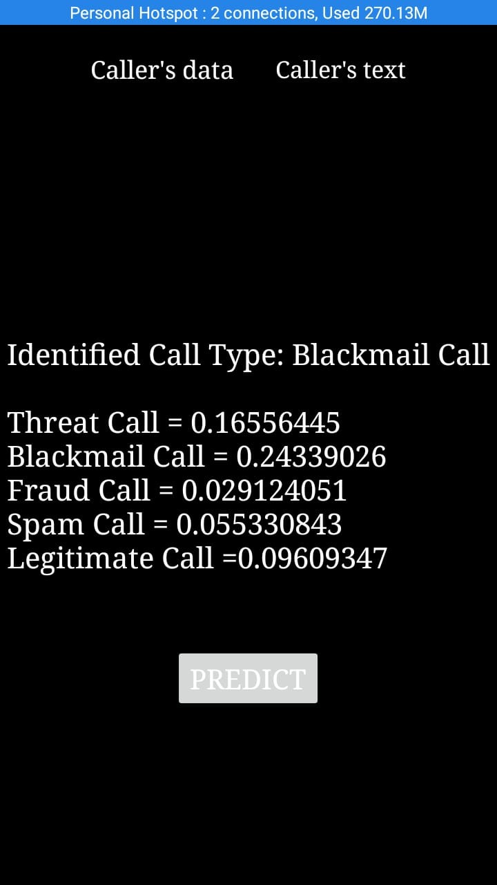
PREDICTION

Slide 22
CONCLUSION
As we have seen that most of the work done is at the end of phone numbers for identifying non-legitimate phone calls but not at the end of conversation data.
In this work, an android app with hybrid approach has been proposed which records the voice call, identifies the non-legitimate phone call by classifying them precisely as spam/fraud/threat/blackmail using Machine Learning, taking transcription of the conversations into notes as input and the audio recording for future references.
It can find applications in many other areas like criminal call tracings and identification etc.
“Is really there any application of technology better than saving one’s life?”

Slide 23
THANK YOU
- Batch B20

